Slide 1
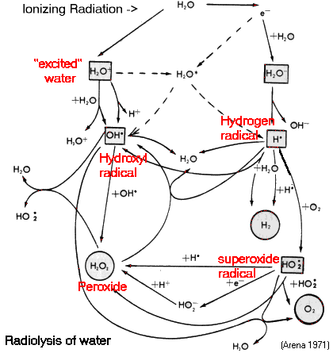
RDCH 702 Lecture 7: Radiation Reactions: Dosimetry and Hot Atom Chemistry
Readings:
Reading: Modern Nuclear Chemistry, Chap. 17; Nuclear and Radiochemistry, Chap. 6, Chap 11.C.
Interaction of radiation with matter
Neutron, positive ions, electrons, photons
Dosimetry
Radiation Protection
Hot Atom Chemistry
Effect in biological systems
Radicals are formed by the interaction of radiation with water
Radicals drive reactions

Slide 2
Interaction of Radiation with Matter
Interaction of radiation with matter leads to:
dissociation of molecules
excitation of atoms or molecules
ionization of atoms or molecules
Ionization is easily measured
used for detection
In air about 35 eV of energy are dissipated for each ion pair formed
Other gases
Xe: 21.9 eV, He: 43 eV, NH3: 39 eV (IP = 10.8 eV), Ge: 2.9 eV
Radiation detected by interaction with matter
Interactions ultimately have the same effect
(35 ev/ion pair formation)
Measure total number of ions produced to determine energy
Energy Loss Overview
At sufficiently high energy ion is bare and energy loss is through electronic excitation and ionization of stopping material
At velocities comparable to the K-shell electron, ion begins to pick up electrons, stopping is still electronic
At velocities comparable to valence electrons elastic collisions account for energy loss
nuclear stopping
No sharp difference point between methods 2 and 3
elastic and inelastic collisions

Slide 3
Positive Ions
Interaction with matter
Neutrons
Very little interaction with electron, primary ionization is negligible
Interaction confined to nuclear effect
scattering (elastic and inelastic)
reactions (n,γ), (n,p), (n,α), (n,2n)
fission
Processes for energy loss
Chiefly by interactions with electrons
Maximum velocity (v) imparted to electron is 2v
K_{E} =0.5mv²; v =(K_{E}/0.5m)²
Consider maximum energy from 6 MeV alpha to electron
Average energy from ions to electrons is 100-200 eV
Secondary ionization
Electronic stopping
inelastic collisions between bound electrons and ion
Excitation of atomic electrons
Nuclear stopping
velocity of ion close to velocity of valence electrons
elastic collisions dominate
Velocity of the ion comparable to K shell electron, ion begins to pick up electrons
Ions passing through matter
stripped of all orbital electrons whose orbital velocity is less than ion velocity

Slide 4
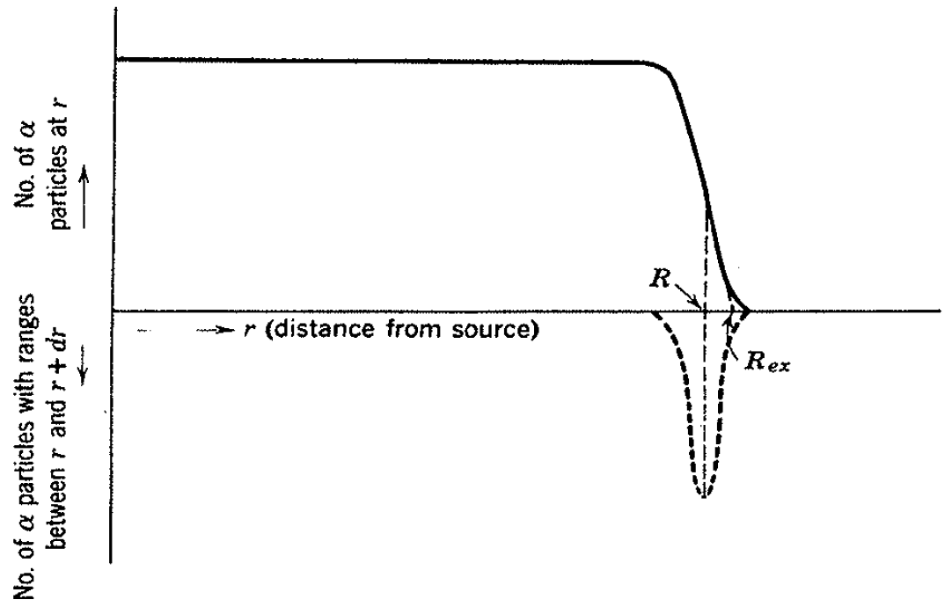
Range
Due to large mass of positive ion compared to electron
distances that positive ions travel in matter are in narrow limits
Particle and energy dependent
Defined as range
Large mass drives behavior
Fractional energy loss per collision is small
large number of collisions required to stop ion
Deflection of ion in each collision is small
Straggling is fluctuations in average energy loss and projected path
order of a few percent
Number of ions from a point source fn(distance)

Slide 5
Electrons
Energy loss
similar to that of positive ions
average ion pair formation about 35 eV in air
70-80% of ionization is secondary
Electron has less mass than positive ions
For the same energy, higher velocity
Lower stopping power
Maximum at 146 eV (5950 ion pairs per mg/cm²)
In air ionization stops around 12.5 eV
Electron can lose a large fraction of energy in one collision
Straggling is more pronounced
Energy loss through electron interaction, nuclear scattering

Slide 6
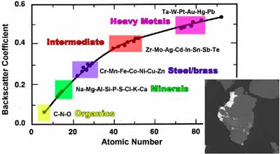
Electron Backscattering
Significant fraction of electrons may be reflected from scattering
Reflected intensity increases with increasing thickness of reflector
Saturation can be achieved
Ratio of measured activity beta source with reflector to that without reflector is back-scattering factor
Factor varies with material
Used to determine Z of material

Slide 7
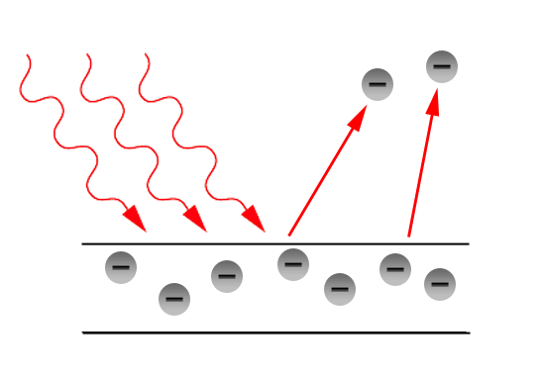
Photons
Lose most energy in a few interaction or a single interaction
Need more material for interaction than electron
Average specific ionization is less than electron (10%)
Average energy loss per ion pair formation in air is 35 eV
Photoelectric effect
photon with energy hv ejects bound electron and imparts energy hv-εb to electron
εb is electron binding energy
Mostly K-shell, some L-shell (about 20%)
Proportional to Z⁵ of absorber
For 5% photoelectric effect, γ energy needed for different Z
Al- 0.15 MeV
Cu-0.4 MeV
Sn-1.2 MeV
Pb-4.7 MeV

Slide 8
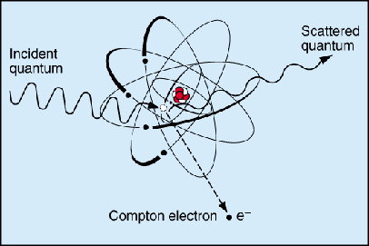
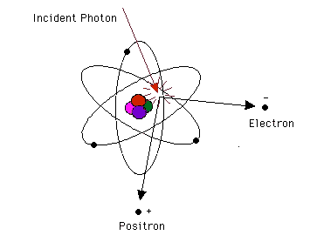
Compton Effect
Pair Production
Photon loss part of energy to electron
Photon is scattered
Minimum for scattered photon is
E_{o}= electron rest energy
Back scattering peak can be seen on spectra
Production of ß⁺ and ß⁻
Proportional to energy (log E about 4 MeV) and Z²
More common at high energy
511 keV from positron-electron annihilation

Slide 9
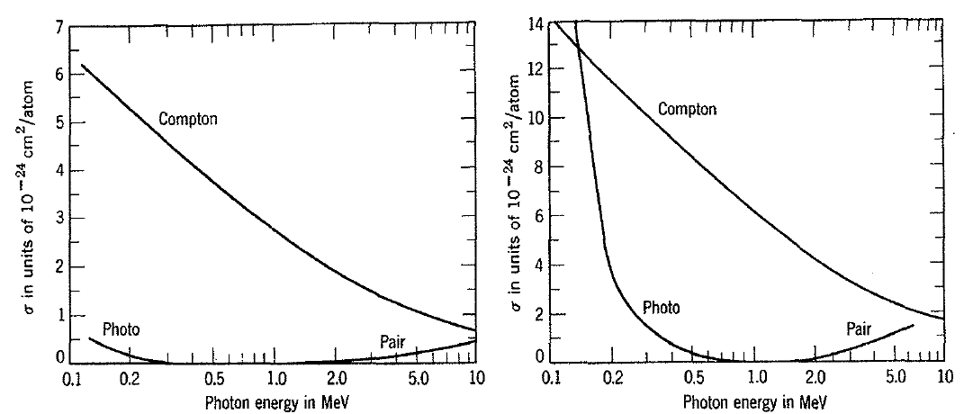
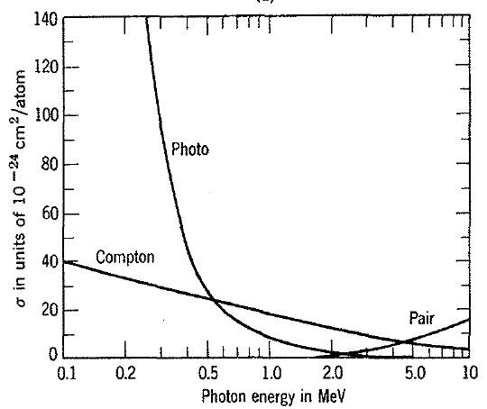
Al
Cu
Pb
Energy Dependence
Effects with different materials

Slide 10
Radiation Dose Units
Radicals are formed by the interaction of radiation with water
Radicals drive reactions
Dosimetry
Quantitative relation between specific measurement in a radiation field and chemical and/or biological changes
dose effect relationship
caused by production of ionized molecules, atoms, secondary electrons
chemical changes, biological effects
Absorbed Dose
energy absorbed per unit mass of target for any kind of ionizing energy
Gray (Gy) = 1J/kg
in US; rad = 100 erg/g
1J/kg = 10⁷ erg/10³ g = 10⁴ erg/g
100 rad=1 Gy
Absorbed dose is referred to as dose
Treated as point function, having a value at every position in an irradiated object
1 eV = 1.60E-19 J
1 charge pair separation =1.60E-19 C

Slide 11
Dose Equivalent
Absorbed dose needed to achieve biological effect is different for different types of radiation
Difference due to high versus low linear energy transfer (LET)
Dose equivalent compensates for this difference
H (dose equivalent) = QD
Q is dimensionless, has some different values
Q=fn(particle, energy); 1≤Q≤20
Q from NCRP Report 116
uses LET (L) in keV/µm in water
Radiation QF
X and γrays 1
Electrons and Positrons 1
Neutrons, E < 10 keV 3
Neutrons, E > 10 keV 10
Protons 1-10
Alpha Particles 1-20
Heavy Ions 20
Q Dependence on LET
LET (L) Q
(kev/µm in water)
<10 1
10-100 0.32L-2.2
>100 300/L^0.5

Slide 12
Dose Equivalent
When dose in Gy, dose equivalent is Sv
When dose in rad, dose equivalent is rem (roentgen-equivalent-man)
1 Gy = 100 rad, 1 Sv = 100 rem
Particle type and energy should be explicitly considered
Biological distribution can depend on isotope
I to thyroid
Sr, Ra to bone
Cs, H widely distributed
Metals go towards liver
Complexes can be released in kidneys
pH change

Slide 13
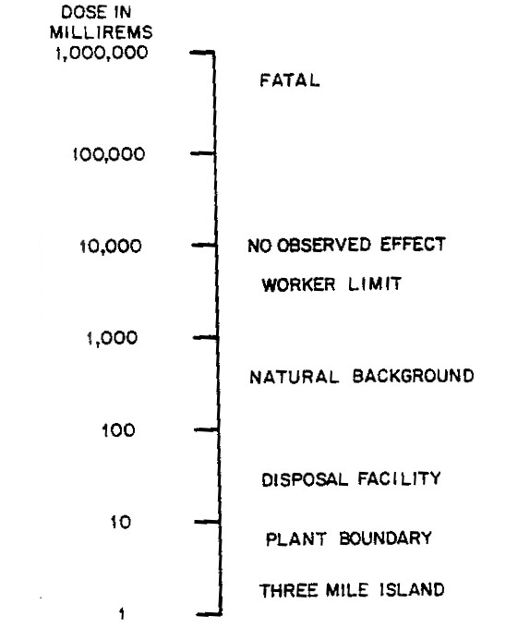
Radiation Protection
6.24 mSv/y Typical background radiation to US public
Value updated
2.4 mSv/y Average dose to US nuclear industry employees. (0.01mSv/y to public)
350 mSv in lifetime Criterion for relocating people after Chernobyl
50 mSv annual worker dose limit
15 µSv to public from Three Mile Island in 50 mile radius
0.4 mSv from dental x-rays
1000 mSv as short term dose: causes (temporary) radiation sickness.
5000 mSv as short term dose: would kill about half those receiving it within a month.
10,000 mSv as short term dose: fatal within days

Slide 14
Dose Calculations
Alpha and Beta
Absorbed dose: D = AE_{ave}x1.6E-13J/MeVx1E3g/kg
=1.6E-10AE_{ave} (Gy/s)
A = conc. Bq/g,
E_{ave}= average energy
Calculated dose of 1.2 E5 Bq of ¹⁴C in 50 g of tissue
ßmax of ¹⁴C is 0.156 MeV
E_{ave}≈ ß_{max}/3 ≈ 0.052 MeV
A = 1.2 E5 Bq/50g
D = 1.2 E5 Bq/50g x 0.052 MeV x 1.6E-10 = 20 nGy/s
What does this value mean?
Average background 6.24 mSv/year
2E-10 Sv/second= 0.2 nSv/s

Slide 15
More Dose Calculations
Photons
µ/r is air energy absorption coefficient
= 0.0027 m²/kg for 60 keV to 2 MeV
D = 3.44E-17 CE/r² (Gy/s)
C in Bq, E in MeV and r, distance from source, in m
gamma energy needs to normalized to %
Dose from 10000 Bq ³⁸S at 0.1 m
95 % gamma yield 1.88 MeV
D= 3.44E-17 x 1E5 x 1.88*0.95 / 0.1²
D = 6.14E-10 Gy/s
Need to consider average gamma energy

Slide 16
Probability Coefficients for Stochastic Effects
Detriment Adult Workers Whole Pop.
(1E-2/Sv) (1E-2/Sv)
Fatal Cancer 4.0 5.0
Nonfatal Cancer 0.8 1.0
Severe genetic
effects 0.8 1.3
TOTAL 5.6 7.3
What is probability of detriment from 2 mSv/y for 10 years to adult worker?
2E-3 Sv/y x 5.6E-2/Sv x 10 y = 1.1E-3
From maximum occupation dose for 30 years
50E-3 Sv/y x 5.6E-2/Sv x 30 y = 0.084

Slide 17
Biological Effects Concepts
Linear Effect of Dose
Any amount radiation above background is harmful
Basis of radioisotope exposure limits
http://www.nrc.gov/reading-rm/doc-collections/cfr/part020/
Low level radiation effect not so clear

Slide 18
Intake limits
Air and water
nuclide specific (include daughter)
Class refers to lung retention (Days, Weeks, Years)
Annual limits on Intake (ALI) derived from 0.05 Sv total dose or 0.5 Sv dose to an organ or tissue
Derived air concentration (DAC) comes from ALI
DAC = ALI/(2000 hr x 60 min/hr x 2E4 mL/min)
Atomic No. | Radio-nuclide | Class | Table 1 Occupational Values |  |  | Table 2 Effluent Concentrations |  | Table 3 Releases to Sewers
 |  |  | Col. 1 | Col. 2 | Col. 3 | Col. 1 | Col. 2
 |  |  | Oral Ingestion ALI (µCi) | Inhalation |  | Air (µCi/ml) | Water (µCi/ml) | Monthly Average Concentration (µCi/ml)
 |  |  |  | ALI (µCi) | DAC (µCi/ml)
95 | Am-241 | W, all compounds | 8E-1 Bone Surf | 6E-3 Bone Surf | 3E-12 | - | - | -
 |  |  | (1E+0) | (1E-2) | - | 2E-14 | 2E-8 | 2E-7
Isotope data found at: http://www.nrc.gov/reading-rm/doc-collections/cfr/part020/appb

Slide 19
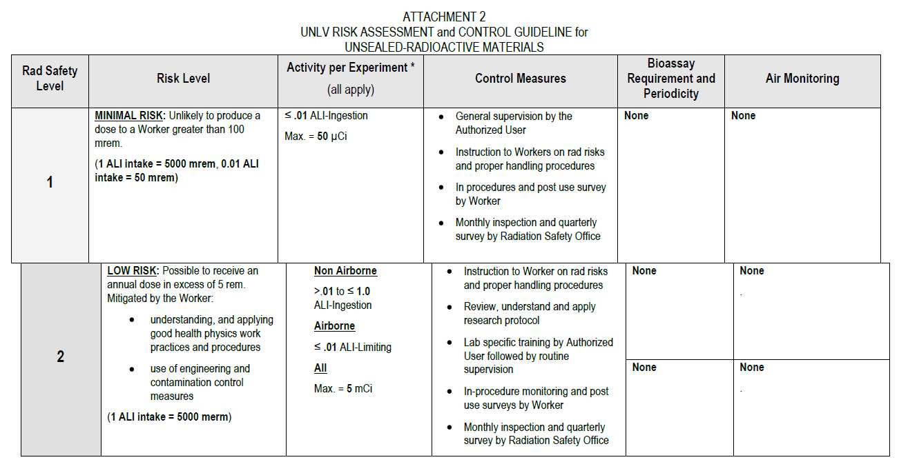
Laboratory usage
ALI and DAC basis of activities levels in the laboratory
http://rms.unlv.edu/radiological/Form%202%20-%20Risk%20Assessment%20and%20Control%20Guideline%20for%20RAM%20(2).pdf
Use data to correlate isotope mass, experimental method, and activity level

Slide 20
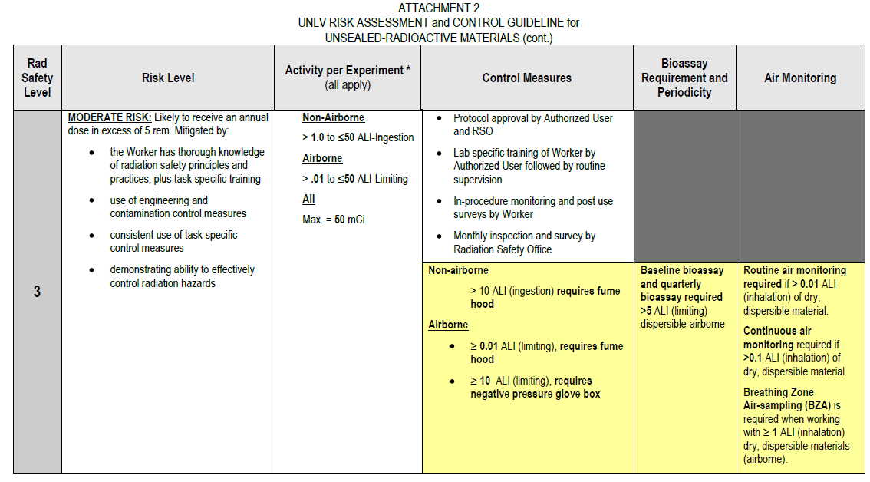
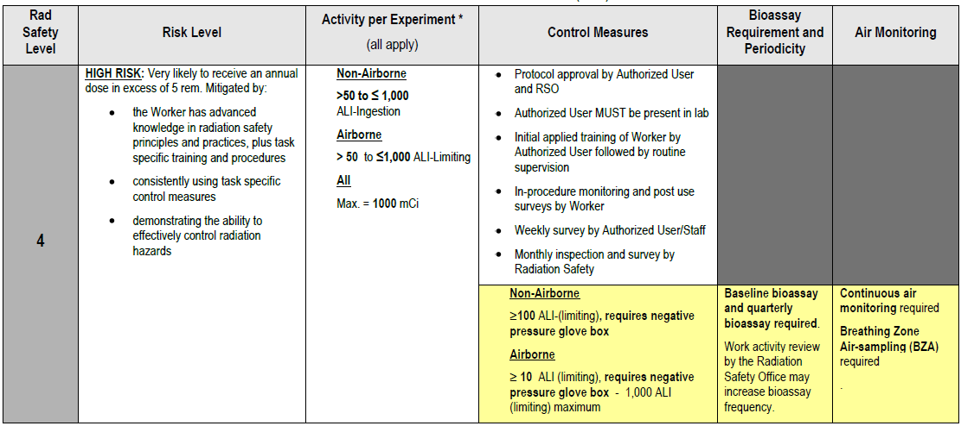

Slide 23
Level calculations
Level 2 for ²³⁸U, non-airborne
Up to 1 ALI-ingestions
10 μCi limit
A=3.7E5 Bq, λ= 4.88E-18 s⁻¹
A/ λ=N, N=7.58E22=0.126 moles=30 g U
Level 3, non-airborne 500 μCi limit
1500 g U, in fume hood
Level 3 for for ⁹⁹Tc, non-airborne
Up to 50000 μCi limit
A=1.85E9 Bq, λ= 1.03E-13 s⁻¹
A/ λ=N, N=1.79E22=2.98E-2 moles=2.95 g Tc

Slide 24
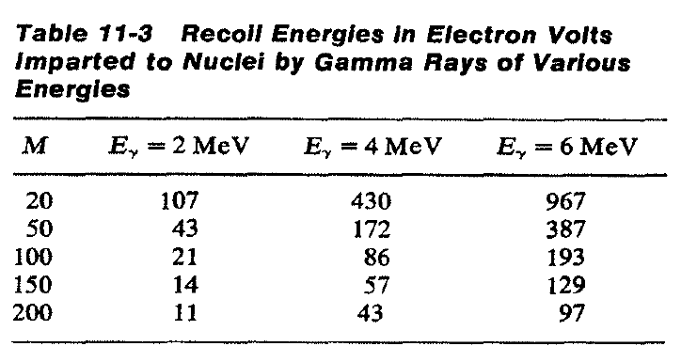
Hot Atom Chemistry
Chemical processes that occur during nuclear reactions
Also called Szilard-Chalmers process
Example: Activity of I extracted from water and ethyl iodide
Precipitated at AgI
Chemical reactions produced by nuclear transformation
Neutron irradiation of ethyl iodide
Iodine extracted into aqueous phase
¹²⁷I(n,γ)¹²⁸I
Possible to produce specific isotope
Need to overcome bond energy
Neutron does not normally contain sufficient energy
Gamma decay can provide suitable energy from recoil
M is atom mass, E is gamma energy in MeV
Nucleus excited 6-8 MeV

Slide 25
Hot Atom Chemistry
Bonds are broken due to reaction energy
Bond energies on the order of eV
Conditions needed
Bond of produced atom must be broken
Should not recombine with fragments
Should not exchange with target molecule
Slow kinetics
Separation of new species
Halogens produced in this method
CCl₄
C₂H₂Cl₂
C₂H₅Br
C₂H₂Br₂
C₆H₅Br
CH₃ I
Used to produce ³⁸Cl, ⁸⁰Br, ⁸²Br, ¹²⁸I

Slide 26
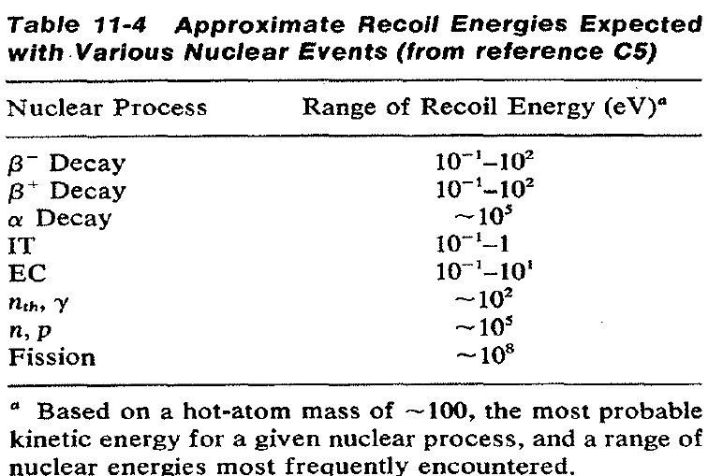
Hot Atom Chemistry: Chemical Reactions
Beta reactions can also be exploited
TeO₃²⁻→IO₃⁻ + e⁻
Recoil is not quantized
Kinetic energy shared
E is maximum beta energy (MeV)
R_{max}(eV)=573E(E+1.02)/M
0.5 MeV in 100 amu is about 4 MeV
Energy is distributed
Translational, rotational, vibrational
Bond usually not broken
Internal conversion set atom in excited state
Rearrangement of electrons and drive chemical reactions
Separation of isomers

Slide 27
Review
Interaction of radiation with matter
Dosimetry
Calculations
Units
limitation
Influence of particles
Measurements
Hot Atom Chemistry
Energetic processes

Slide 28
Questions
Compare DAC for isotopes of Pu and Cs
Perform a dose calculation for 1 mg internal exposure of ²¹⁰Po
Use DAC to evaluate experimental limits for ²⁴¹Am
Calculate the dose from 500000 Bq of ²⁴¹Am at 0.050 m
What are the different masses of ⁹⁹Tc permitted for the various laboratory safety levels at UNLV.
What are the principles of hot atom chemistry

Slide 29
Questions
Comment on the blog
Respond to PDF Quiz 7

